Slide 1

Temporal Uber Traffic Fluctuations New York City Case Study
Contributors:
Jane Lee | Lillian Zhao | Prof. Manning
Notes:
Prepare some pdf, Powerpoint, Keynote, or Google slides where you motivate your question and dataset (e.g. why is it interesting?), paste in some figures from your Jupyter notebook, and use them to tell a story about what you found.

Slide 2
Motivation:
People in NYC
Rise of Uber/Lyft/ride-sharing in contrast to old taxi usage
Traffic in general

Slide 3
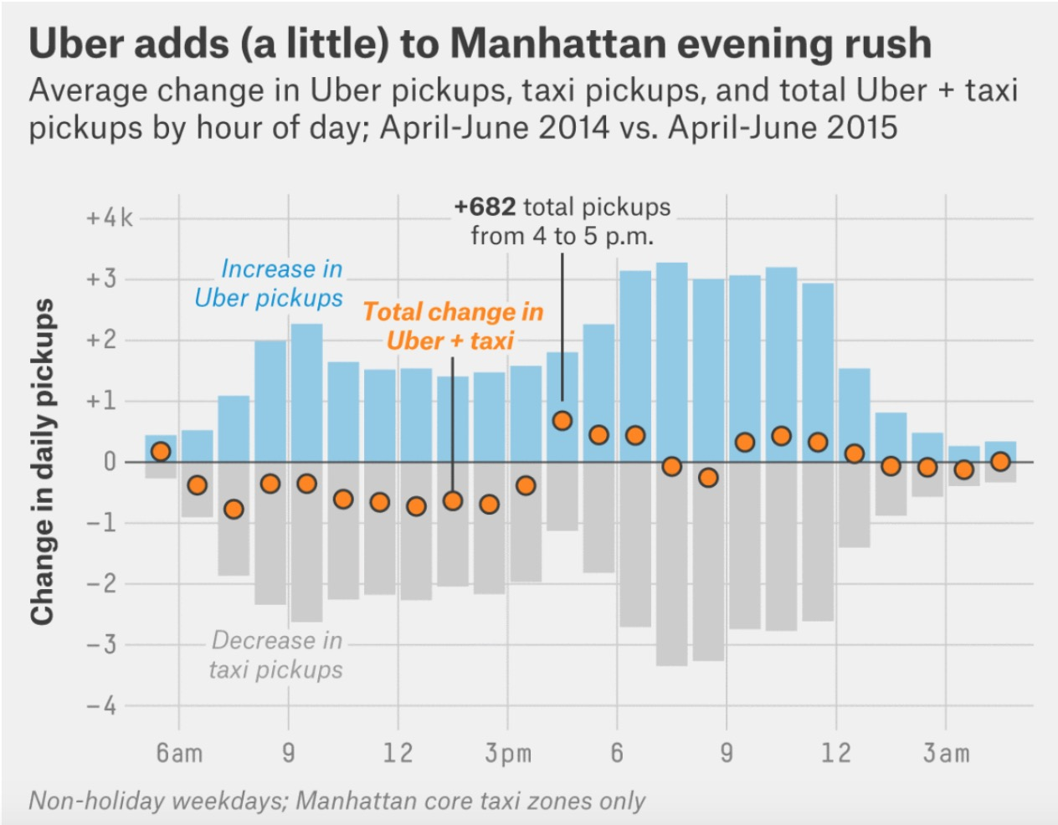
Motivation:
FiveThirtyEight analysis of NYC Uber data insights:
Uber adds (a little) to Manhattan evening rush traffic
Thousands of pickups outside of Manhattans core
Unanswered questions inspired by this analysis:
How does Uber usage compare on the weekend?
How do seasonal changes affect rush hour traffic and daily temporal fluctuation?
What does this movement *look* like?

Slide 4
Data Set:
Uber Trips Data
All NYC Uber Trips: April 2014 through June 2015, provided in .csv by month
Each file contained: Date/Time, Lat, Lon, Base (Driver)

Slide 6
Graph with rides per day of week & seasons to juxtapose OG
After accounting for key covariates:
Non-Hispanic black households held $2,000 less than non-Hispanic white households in net worth at 10th percentile
$61,000 less at the median
$194,000 less at the 90th percentile
Hispanic households held $2,800 more than non-Hispanic white households in net worth at 10th percentile
$45,000 less at the median
Few significant differences at the 90th percentile

Slide 7
Group Discussion: Appropriate Methods?
Unconditional Quantile Regression > OLS
Conditional Mean v. Conditional Median or other Quantiles
Cases of extreme quantiles (hospital wait-times, abnormal growth charts)
Comparison along the Distribution of Wealth
More robust against outliers in response measurements
Decomposition Models

